Slide 1
HA7162 Ruby 6192_P1_ASI Fe buried PD defect report
PIE/YE
08.22

Slide 2
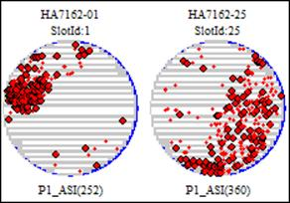
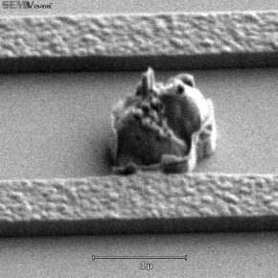
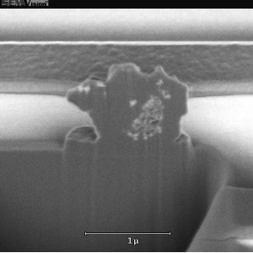
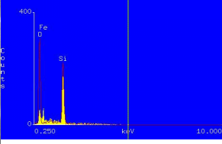
HA7162 6192_P1_ASI suffer Fe buried defect
Defect 分析思路 by step
SEM OM EDX 收集清楚
加扫确定是否by chamber
看lot history 是否正常,前值是否正常 找到 怀疑点 缩短怀疑 loop
搜索Lesson learn确认 是否第一次发生
FA&TEM 切片分析
确认是否是process 相关，对比同 Tech 产品 是否有impact
对比flow & module process recipe 差异
Co-work PIE 进一步实验分析 （条件split）
Issue Description:
  2016-08-22 01:30 ET scan HA7162 6192_P1_ASI all wafers find buried defect , random map, EDX: Fe. MAX DD:27%; follow SOP: informed Facility and WET/Fur.
Impact:
  No impact lots, killer ratio: ~35%
Analysis Methodology:
  Check EDX: Fe, do FIB defect under Poly
  Notch position suspect loop Gate1_OX to P1_DEP
  Check WET:HDWOX01/HDGOC03,/HDGOC04 and Fur: DGOX06/GOX07/UPY02 process log and offline particle normal
  Scan batch and pre post lots defect normal
  Facility feedback : Gas/Chemical/Water/Mech. all normal
  EE check tool no find abnormal
  Add T/W at impact position check offline particle normal
  Pi run 1 batch production, scan impact position lot defect OK
Root Cause / Hypothesis:
  Suspect metal ion contamination from tool machine frictional particle
Lot& Machine disposition
  HA7162 scrap #01,25 2pcs, tool keep run
Typical map
EDX: Fe

Slide 3
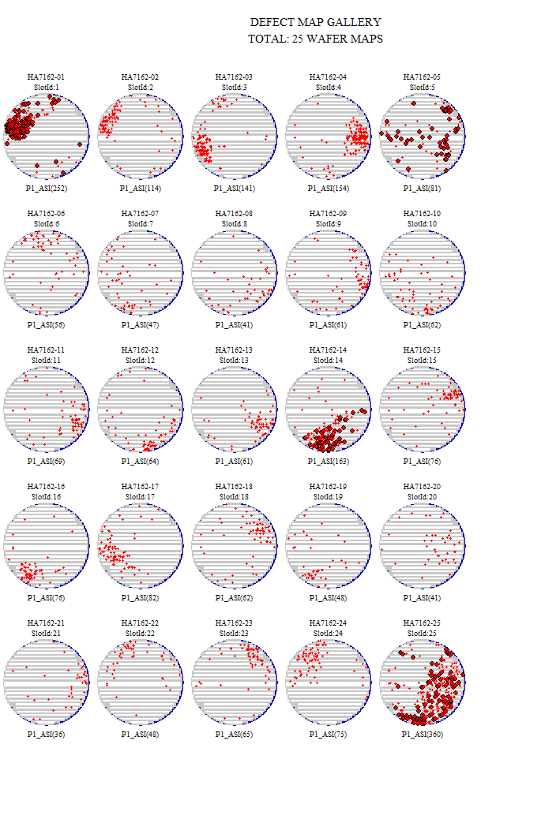
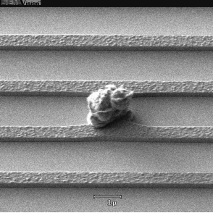
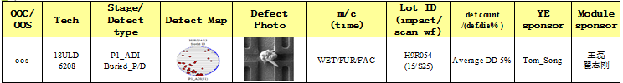
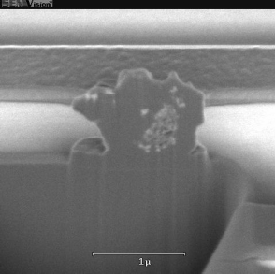
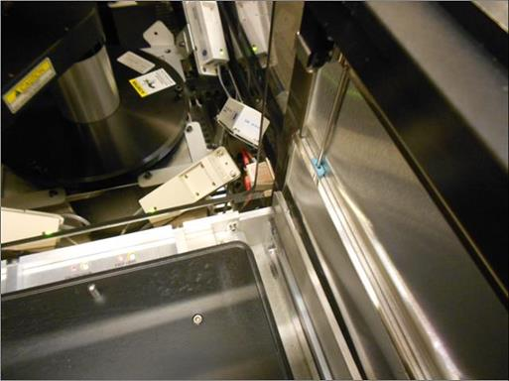
HA7162 Ruby 6192_P1_ASI Fe buried PD defect report
Lesson learn
Map
SEM
Problem Statement:
Lot suffer spider issue with random notch direction.
Spider issue was beneath Poly film.
After FIB to check core of defect EDX show “Fe” element.
Size:1~2um,AIT:AVG DD: 7.47%,Max DD: 27.58%
Lesson learn:
PMIC4 suffer this issue with HDTKR02 (Ruldoph) left SMIF dirty @Gate_OX .-------- But this time feature wasn’t match( all TKR measurement Test wafer).
FIB
Same defect lesson learn:
TKR* SMIF
All wafer suffer Spider issue
With random notch direction.
The core of defect’s EDX shows “Fe” element.
EDX
YE Action：Lead case ,Push module feedback, Summary report
Action:
Check suspect loop impact list---------------YE done(All impact list was okay within suspect loop).
FAC feedback Gas/Wafer/Mech/Chemical checkpoint. ---------------FAC done (All was okay).
WET check TXRF and Acid sample and other checkpoint. --------------- WET done.(All was okay)
Fur check Test run and Hardware checkpoint. ---------------Fur done.(All was okay)

Slide 4
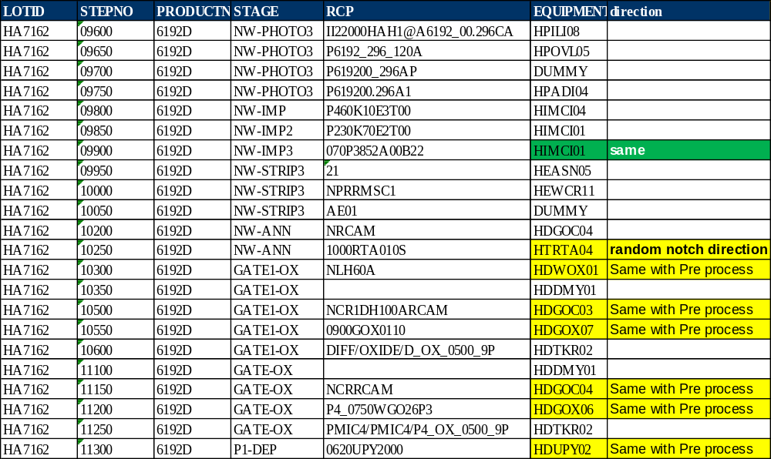
HA7162 Ruby 6192_P1_ASI Fe buried PD defect report
Suspect loop:
Base on Notch direction suspect loop was Gate and Poly.
YE Action：第一时间
Defect loop 锁定 ，notch 方向 defect type FIB
Suspect loop
YE Action：
YE handle and inform time line was speedly (including FIB X-section).
Time line
HDUPY02 Track out
2016-08-20 03:22
YE inform WET and Fur
2016-08-22 1:10
YE send mail inform correlative module
2016-08-22 4:35
ET finished follow runcard and
inform YE 2016-08-22 00:58
YE do FIB and find defect element is Fe
2016-08-22 4:00
45hous 36mins
3hours 37mins

Slide 5
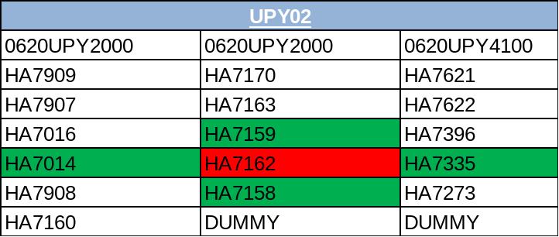
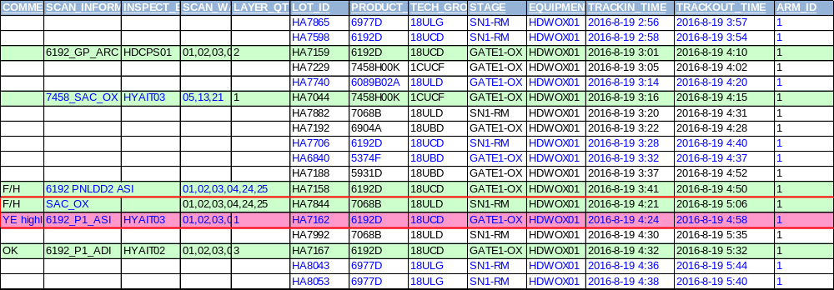
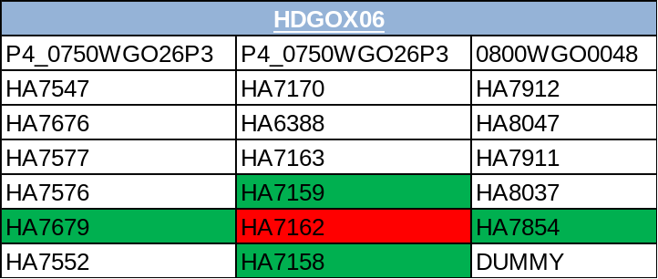
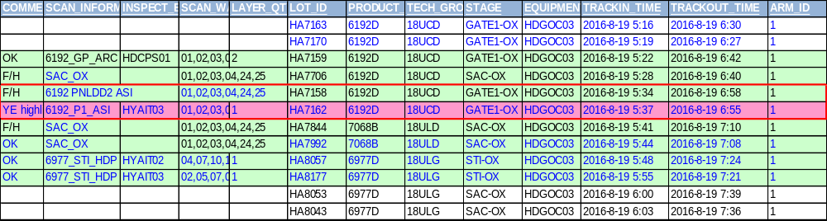
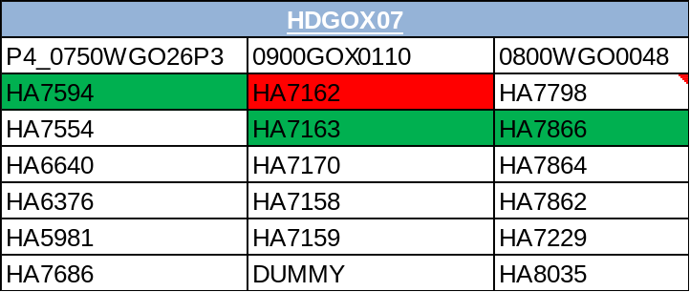
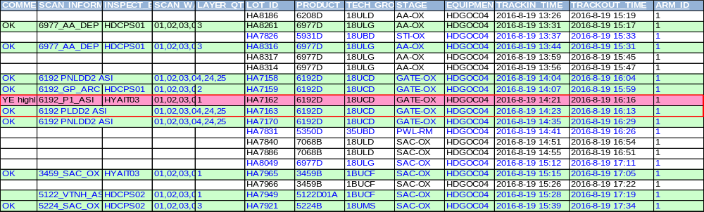
HA7162 Ruby 6192_P1_ASI Fe buried PD defect report
Suspect loop:
Check all suspect loop including WET and Fur batch lot all was okay.
YE 参与 impact trace 完善报告，持续追踪

Slide 6
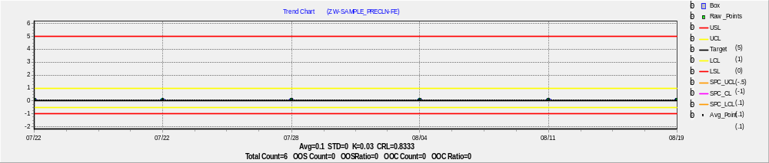
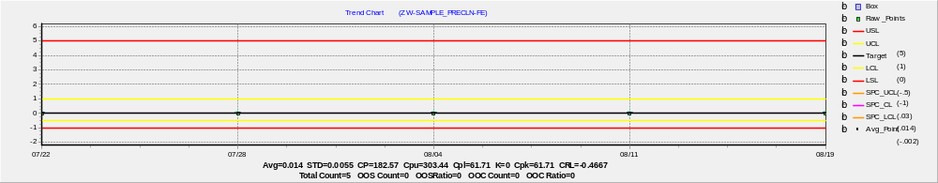
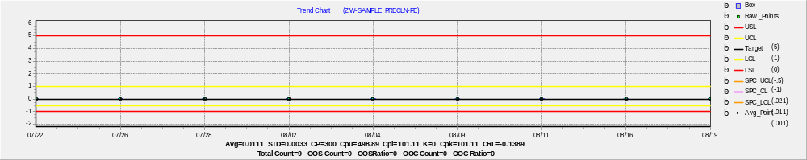
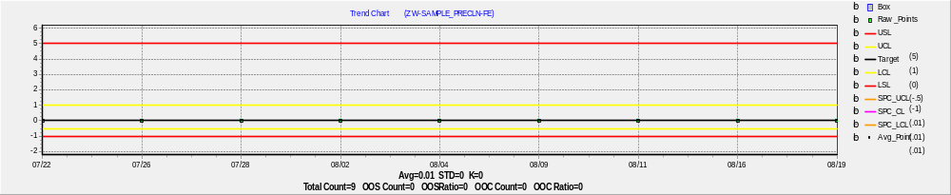
HA7162 Ruby 6192_P1_ASI Fe buried PD defect report
WET Action:
Module 提供 data YE 负责整合
2016-8-19 11:00 normal sample data ,Fe element all is normal
Routine Sample data ok
HDGOC03
SPM
1404/68
DH
166/9
SC1
158/9
SC2
144/8

Slide 7
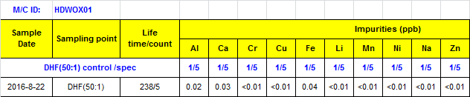
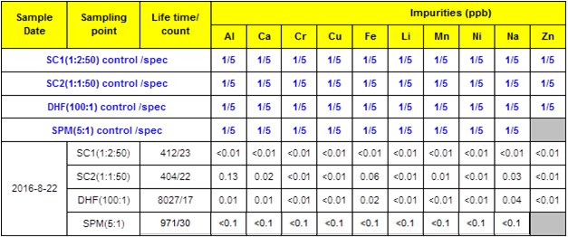
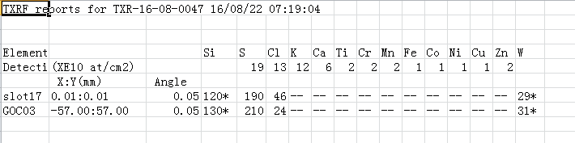
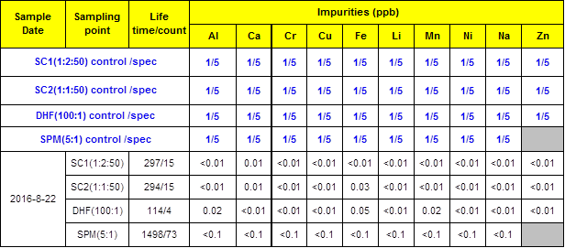
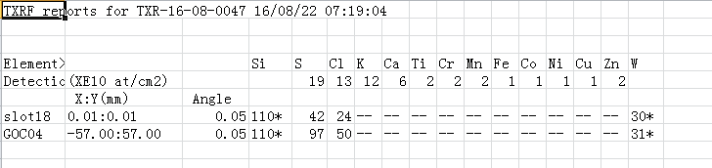
HA7162 Ruby 6192_P1_ASI Fe buried PD defect report
2016-8-22 6:00 special sample data and TXRF data , Fe element all is normal
Sample data : Fe element
Module 提供 data YE 负责整合
HDWOX01
TXRF data : Fe element
HDGOC03
HDGOC04

Slide 8
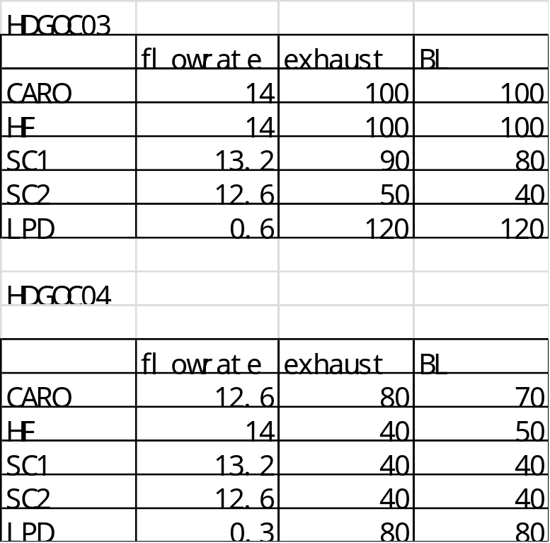
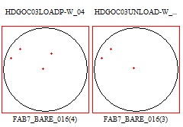

HA7162 Ruby 6192_P1_ASI Fe buried PD defect report
Equipment data
Module 提供 data YE 负责整合
Special check Equipment data
Flow rate and exhaust all is match baseline
Special test load/unload SMIF PAC ,all is adder 0/0
HDGOC03
HDGOC04

Slide 9
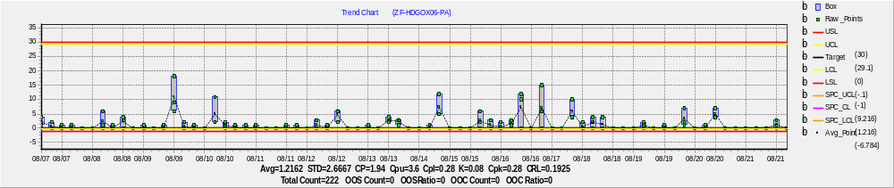
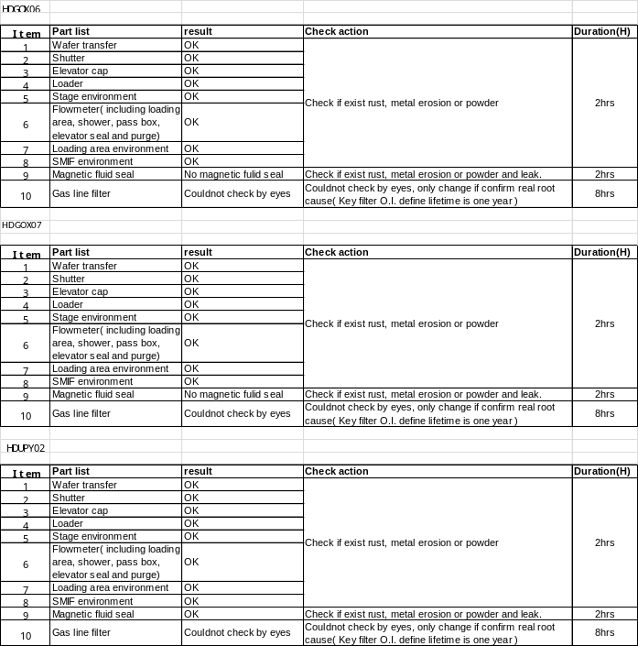
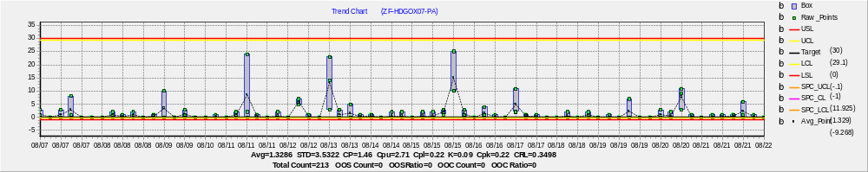
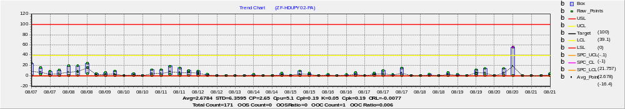
HA7162 Ruby 6192_P1_ASI Fe buried PD defect report
Fur Action:
Module 提供 data YE 负责整合
Fur check Hardware and tool offline particle performance was okay.
Offline particle normal.
Follow up actions:
EE do Load->Charge->Discharge->unload repeat test, defect adder < 10ea.
HDGOX06/07 do test run, defect data pass, HDUPY02 doing test run.
PE will trace the 3 tools defect performance after release by inline defect scan.

Slide 10
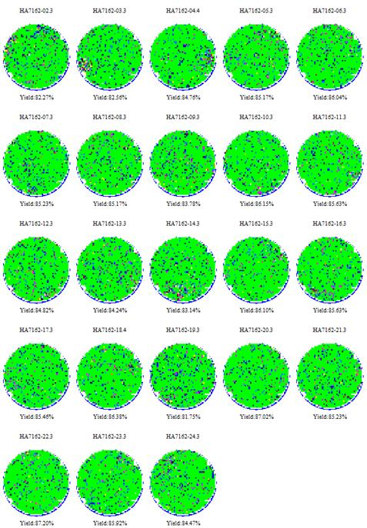
HA7162 Ruby 6192_P1_ASI Fe buried PD defect report
CP3 yield
YE 负责 持续跟踪 CP feedback 记录Killer ratio
Baseline CP3: 88%, yield loss~3%
Killer ratio:
AIT:35%,
KLA: 25%
Average: 84.97%

Slide 11
Thank You

Slide 12
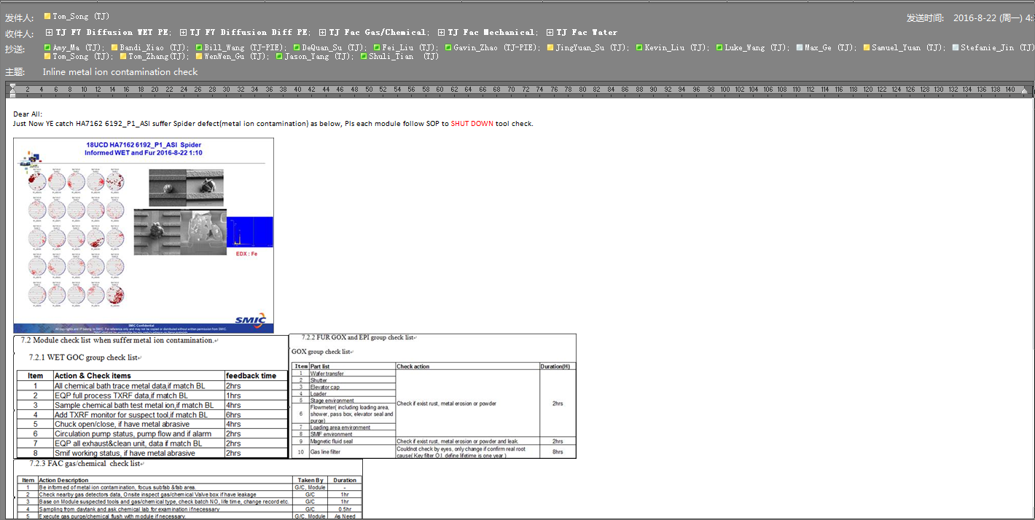
Follow SOP handle

